Slide 1

T
CUAI 논문 리뷰 스터디 (NLP) 팀
2022.03.02
발표자 : 전용현

Slide 2
스터디원 소개 및 만남 인증
스터디원 1 : 김예원(AI)
스터디원 2 : 김태환(AI)
스터디원 3 : 전용현(AI)

Slide 3
목차
Reasoning Problems
Few-Shot CoT
Zero-Shot CoT
Auto CoT
Self-Consistency CoT
Instruction Fine-Tuning

Slide 4
1
Reasoning Problems

Slide 5
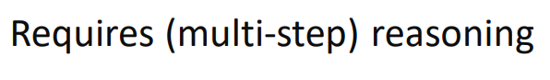
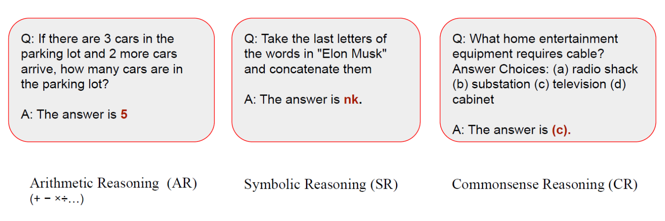
Coin flip
Last Letter
Concatenate

Slide 6
2
Few-Shot CoT

Slide 7
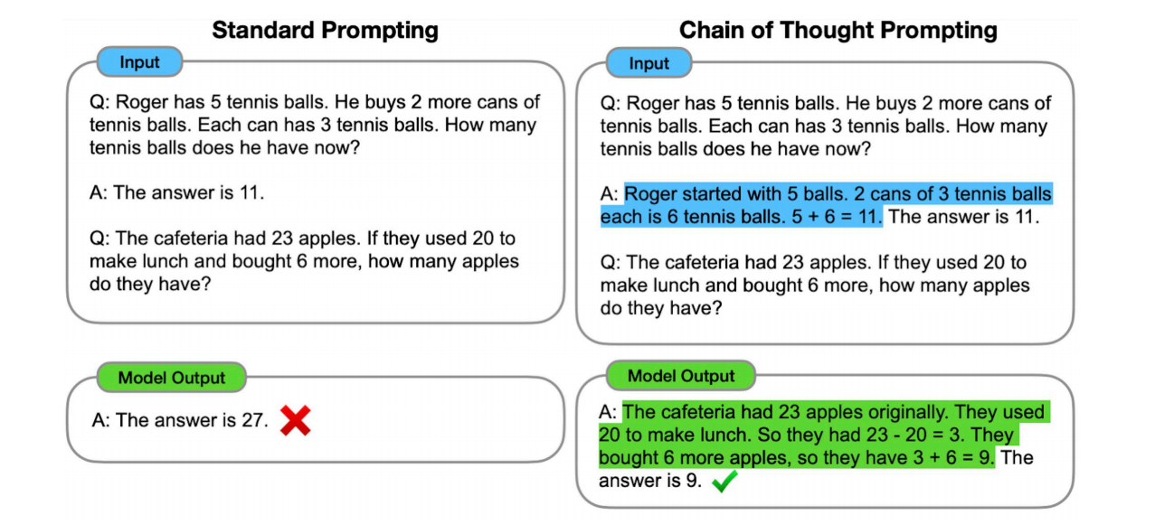
Few-Shot CoT

Slide 8
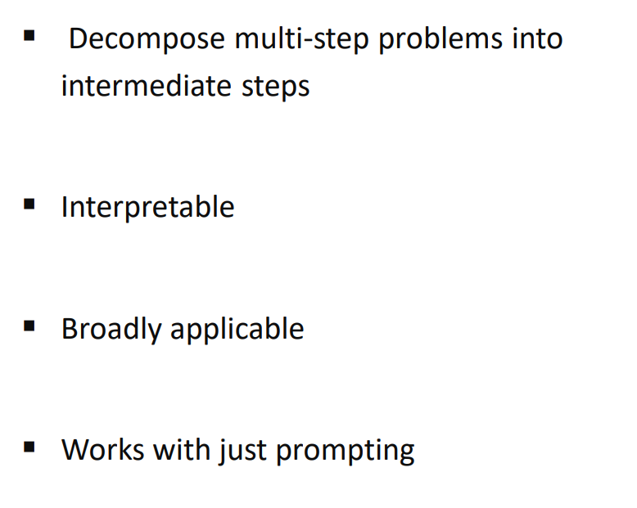
Properties
목적: Endow language models with the ability to generate a similar chain of thought.

Slide 9
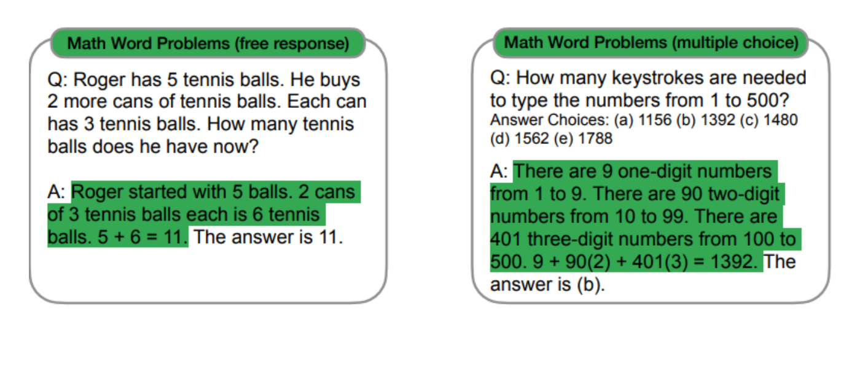
Arithmetic Reasoning Example

Slide 10
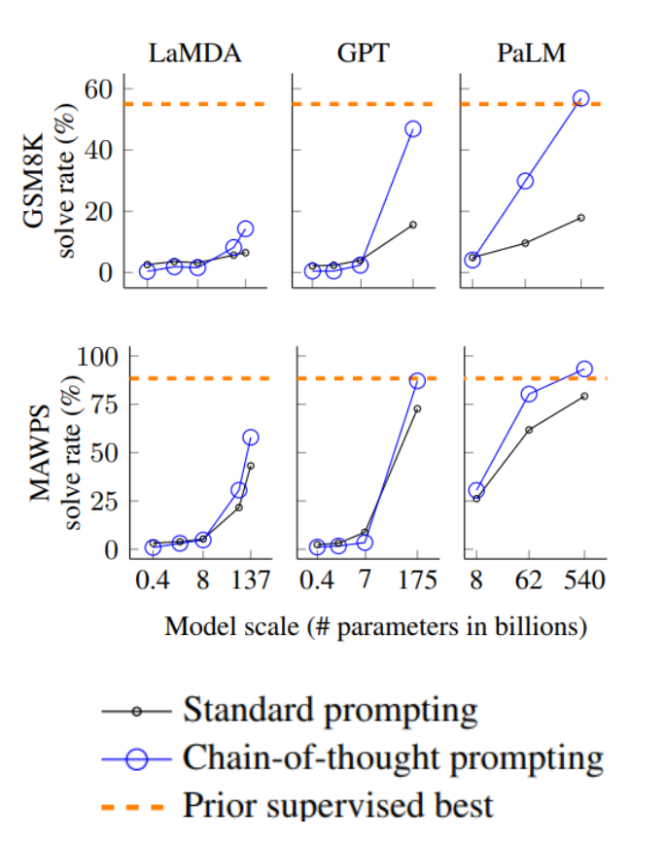
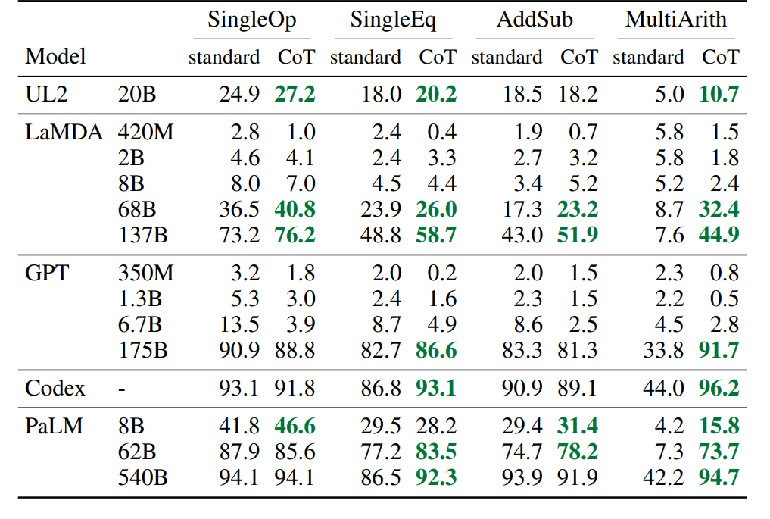
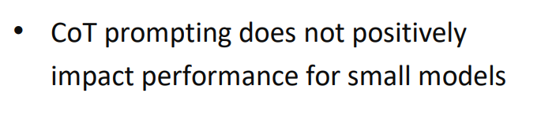
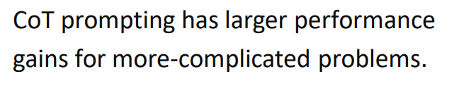
Arithmetic Reasoning Evaluation
Fluent, illogical CoT → leading lower performance

Slide 11
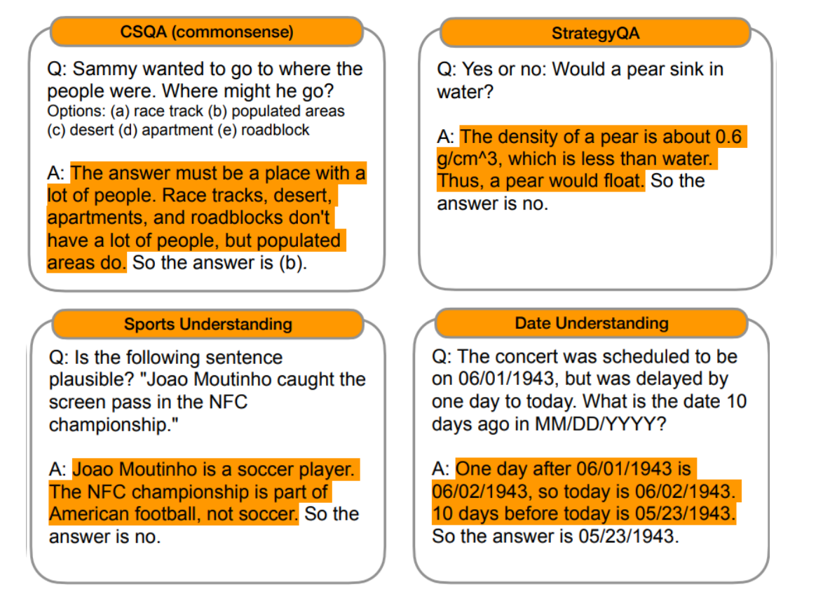
Commonsense Reasoning Example

Slide 12
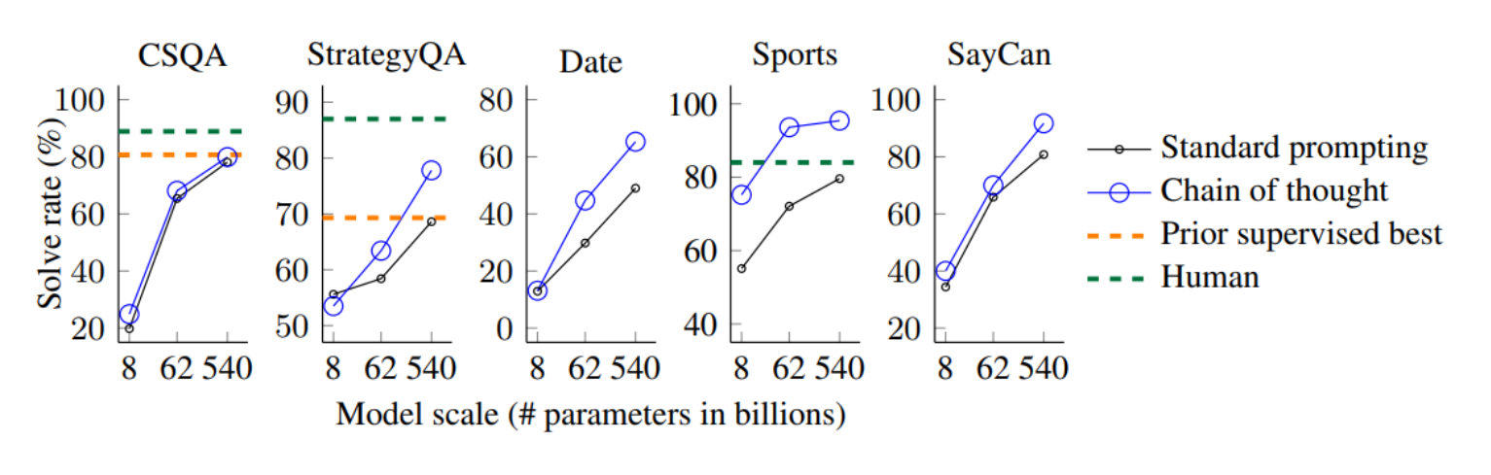
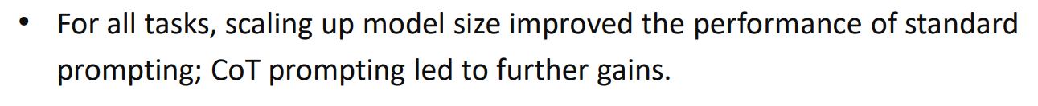
Commonsense Reasoning Evaluation

Slide 13
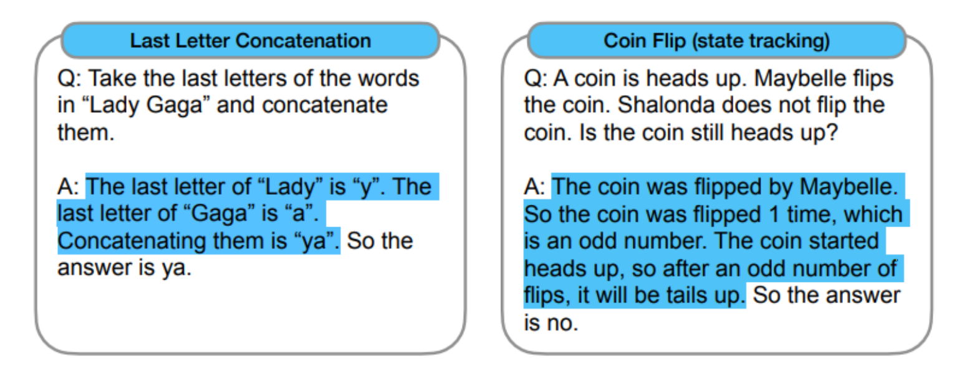
Symbolic Reasoning examples

Slide 14
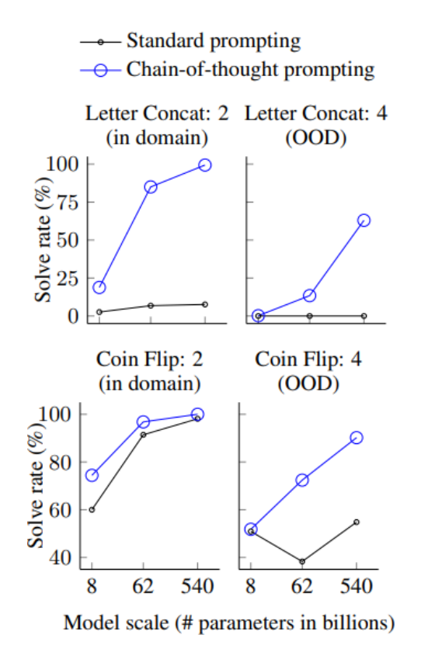

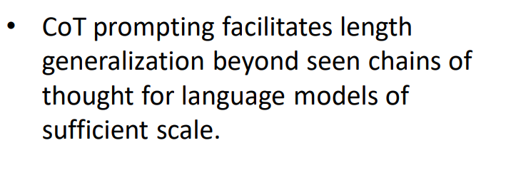
Symbolic Reasoning Evaluation
2 words/coin flips - train
in domain -
2 words/coin flips - test
2 words/coin flips - train
OOD -
3~4 words/coin flips - test
(PaLM)

Slide 15
3
Zero-Shot CoT

Slide 16

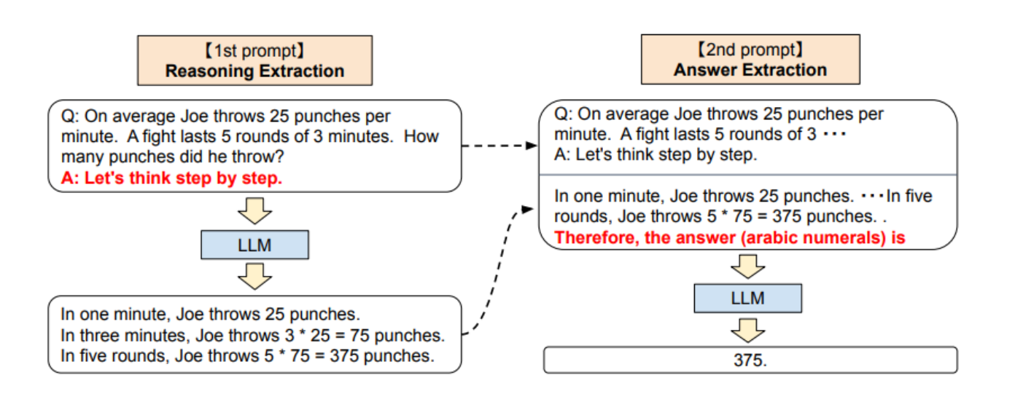
Zero-Shot CoT
1st Prompt: Reasoning Extraction – template “Q:[X], A:[T], output: Z”
[X]: input sentence, [T]: CoT trigger sentence(“Let’s think step by step”)
2nd Prompt: Answer Extraction – template “Q:[X’] + [Z], A:[T’], output: Answer”
[X’]: X + T, Z: generated reason, [T’]: answer trigger sentence

Slide 17
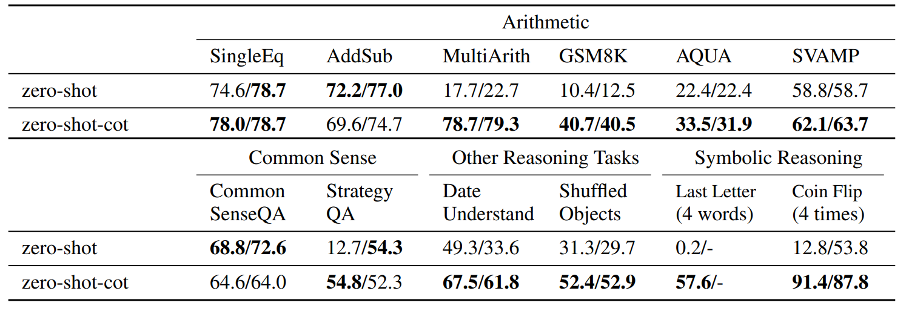
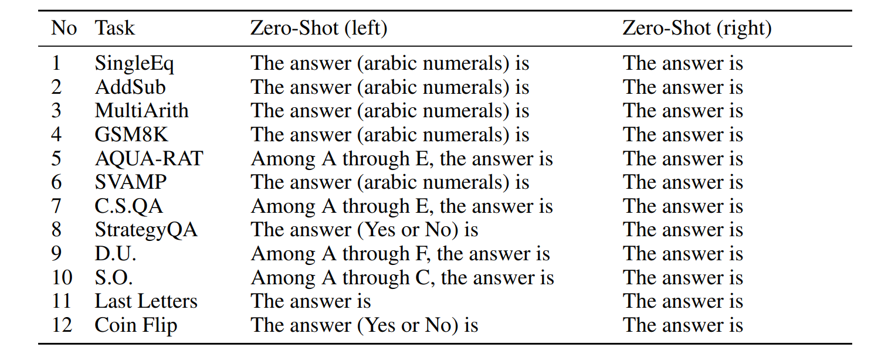
Zero-Shot CoT Evaluation (tasks)
Task가 어려울수록, 성능이
더욱 향상되었다.
Commonsense task 같은 경우에는
유의미한 성능 향상이 있지 않았다.

Slide 18
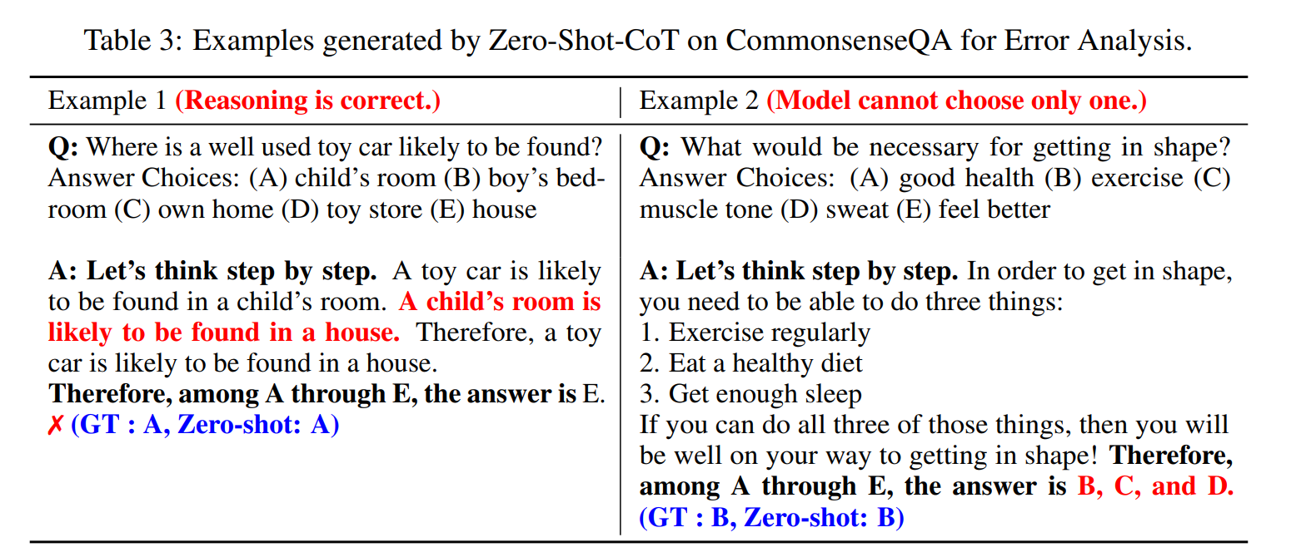
Error Analysis
Answer Cleansing: After the model outputs a text by answer extraction,
our method picks up only the part of the answer text that first satisfies the answer format.

Slide 19
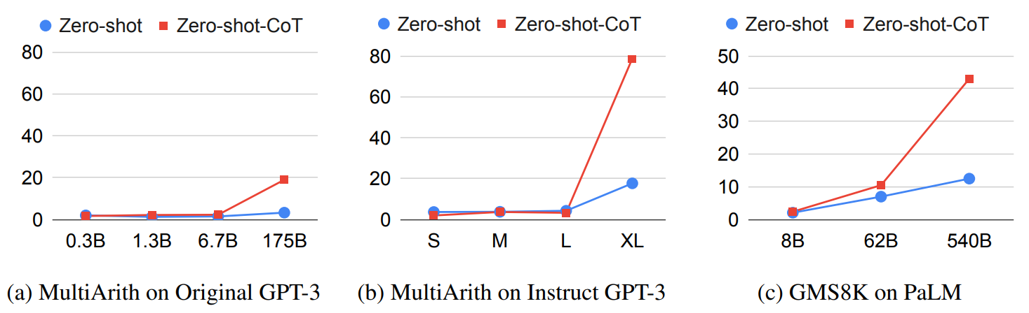
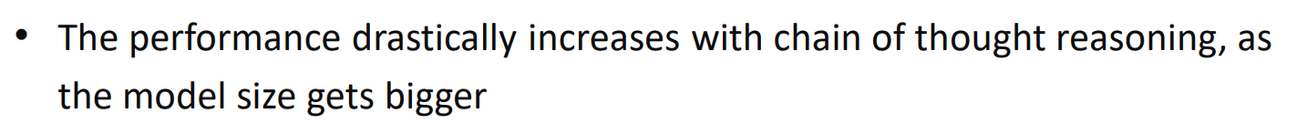
Zero-Shot CoT Evaluation (model size)

Slide 20
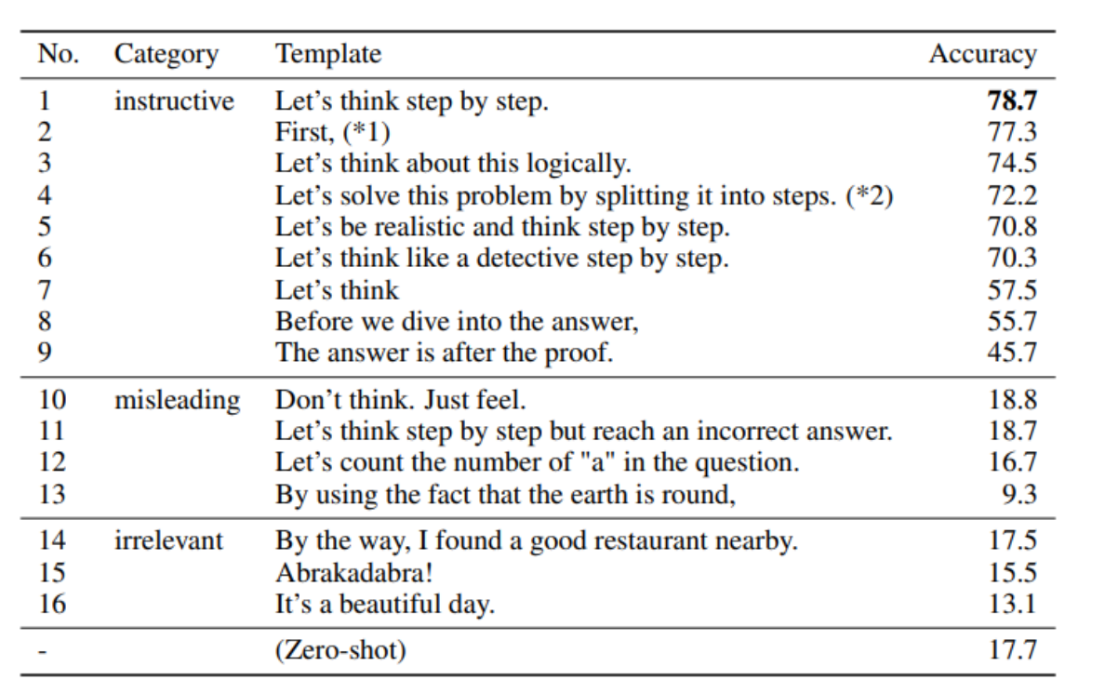
Robustness Study

Slide 21
4
Auto CoT

Slide 22
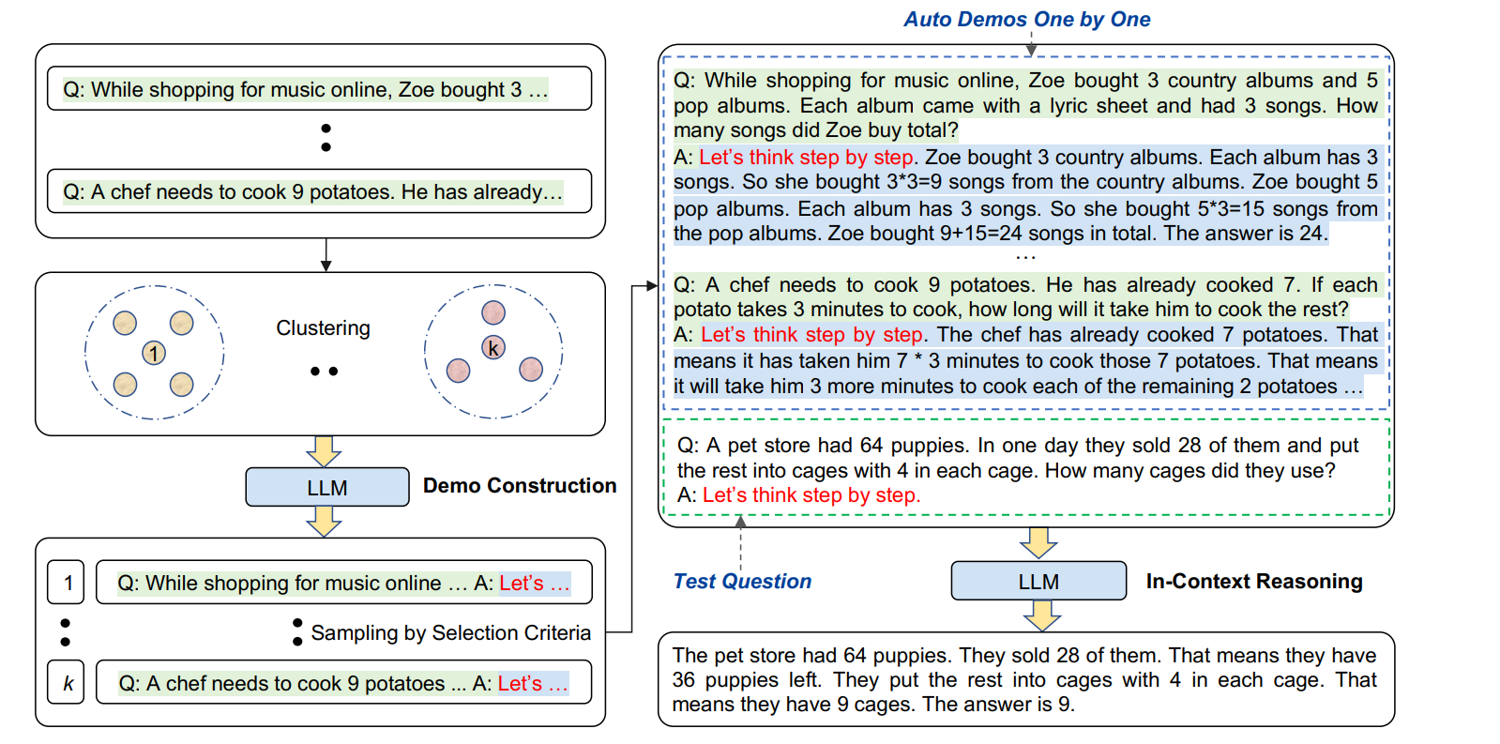
Auto CoT
Question clustering
Demonstration sampling

Slide 23
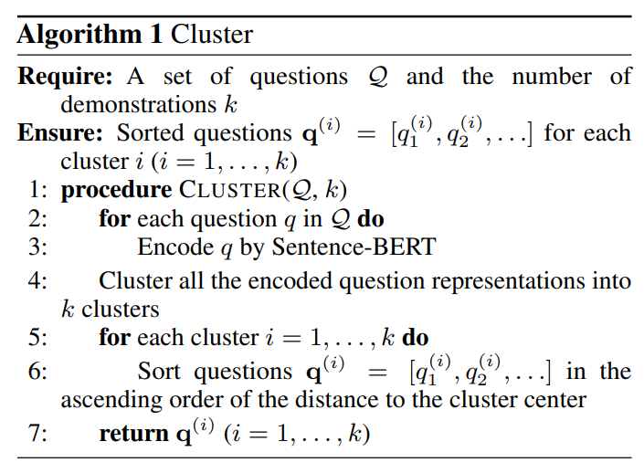
Questioning Clustering

Slide 24
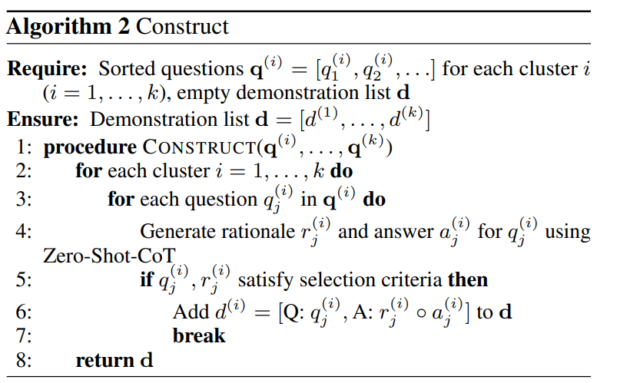
Demonstration Sampling
Selection criteria ex) Question with less than 60 tokens, reasoning with less than 5 steps, …

Slide 25
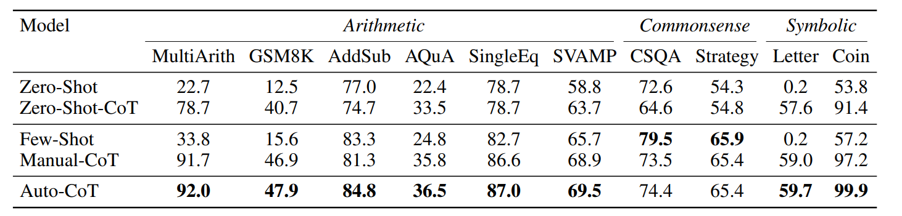
Auto CoT Evaluation
LLM model: GPT-3

Slide 26
5
Self-Consistency CoT

Slide 27
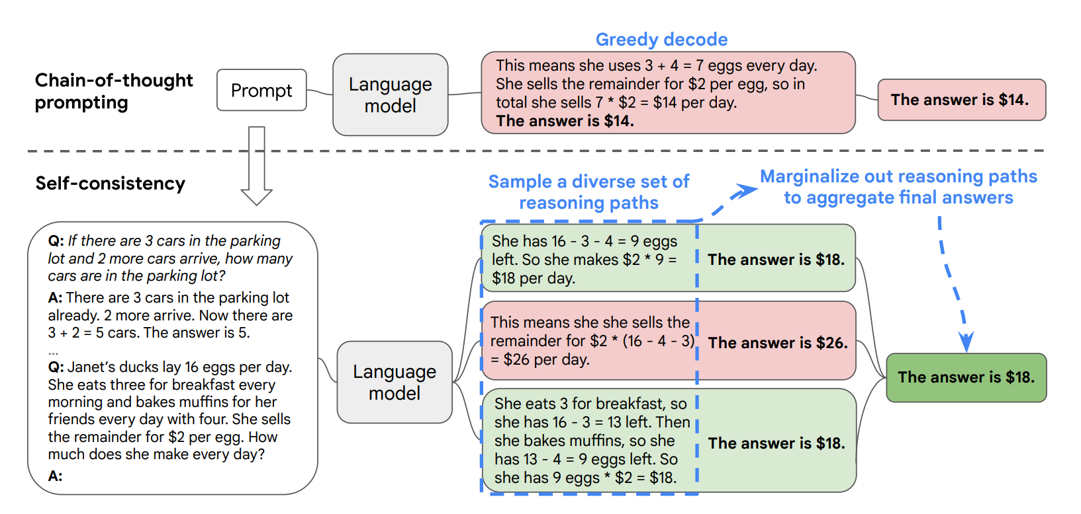
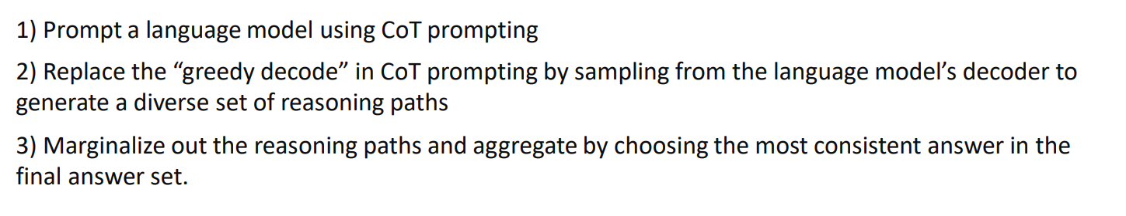
Self-Consistency CoT

Slide 28
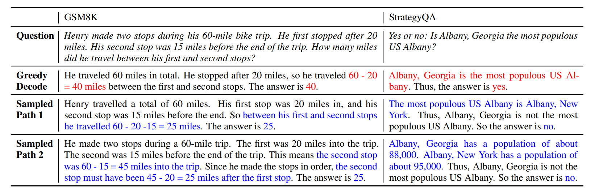
Self-Consistency CoT example

Slide 29
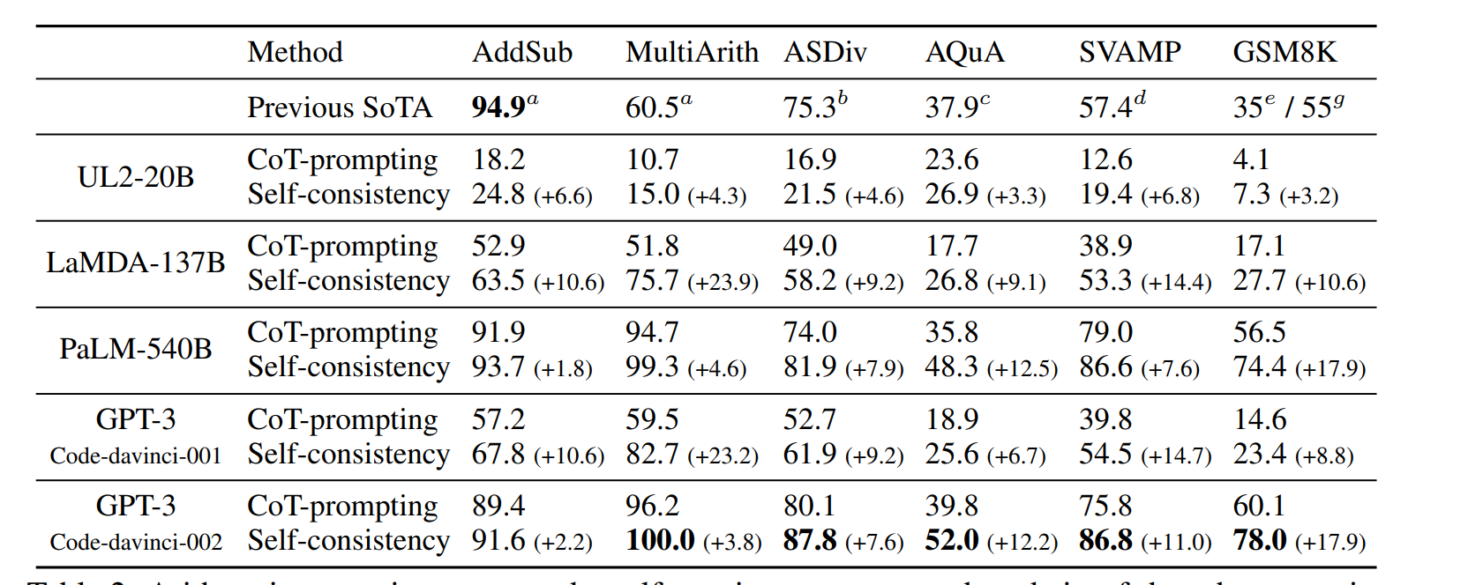
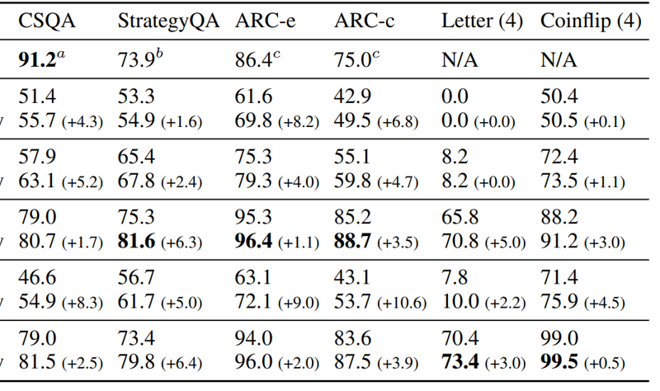
Self-Consistency CoT Evaluation

Slide 30
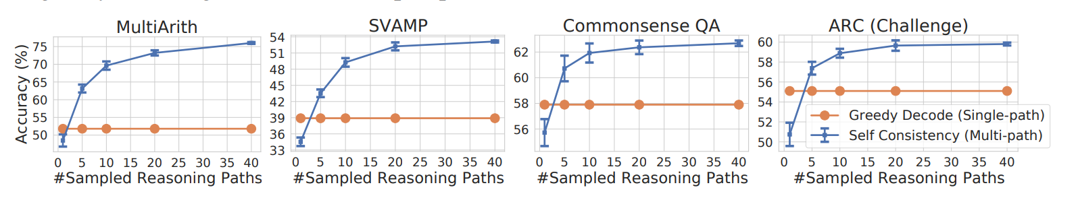
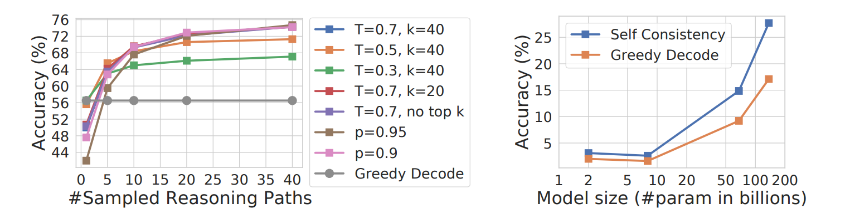
Self-Consistency CoT Evaluation

Slide 31
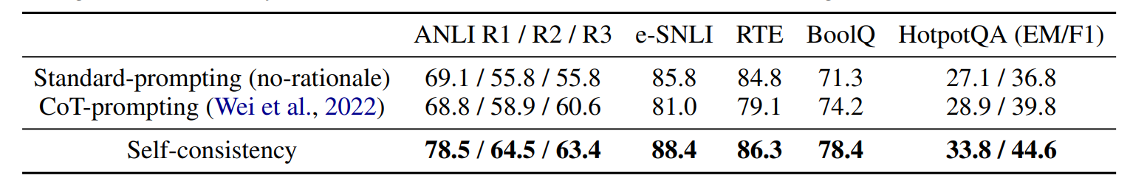
Self-Consistency CoT repairs errors

Slide 32
6
Introduction Fine-Tuning

Slide 33
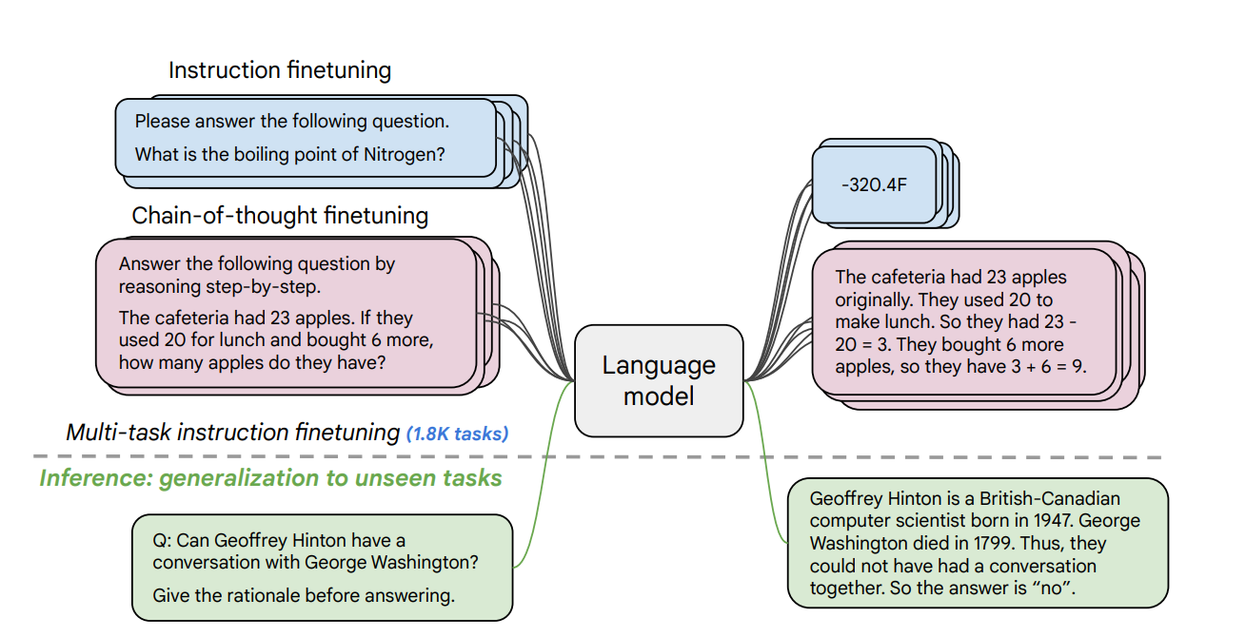
Introduction Fine-Tuning
Multi-task finetuning 과정에서 task 개수를 1800개 이상으로 증가, 모델 사이즈도 증가
→ 성능 향상!
2. CoT task 추가 → 성능 향상!

Slide 34
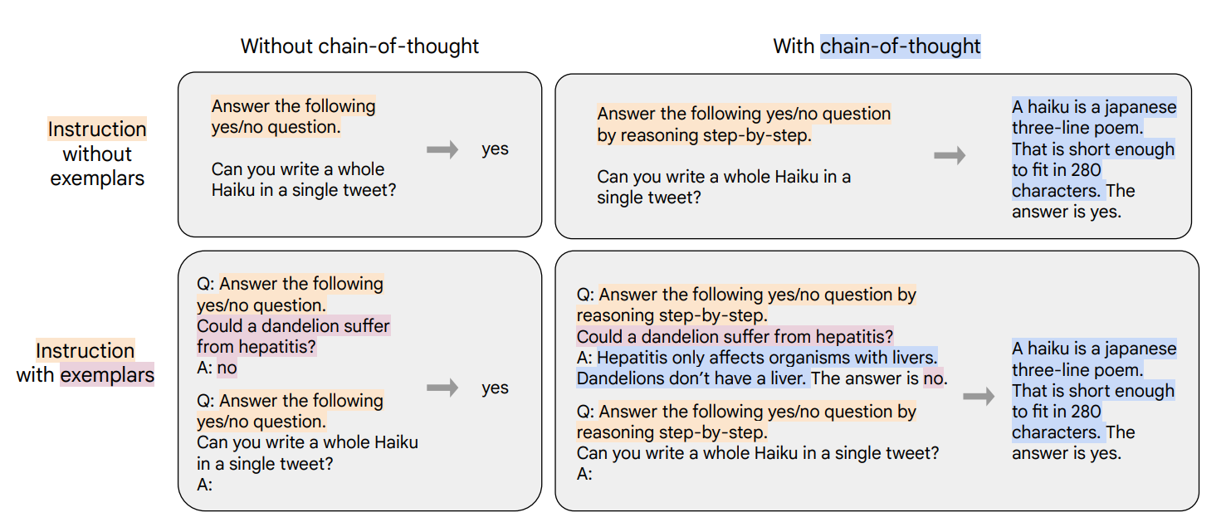
Templates
나머지 tasks template: 기존 template 이용
→ Apply randomly for each CoT examples

Slide 35
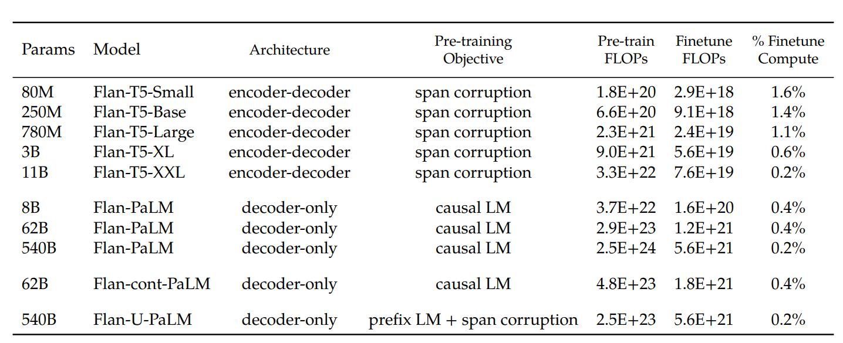
Flan
Flan: collection of data sources
Variety of instruction types
fine-tune
→ Pre-train의 compute 양에 비해, Fine-tune의 compute 양이 상대적으로 굉장히 작다.

Slide 36
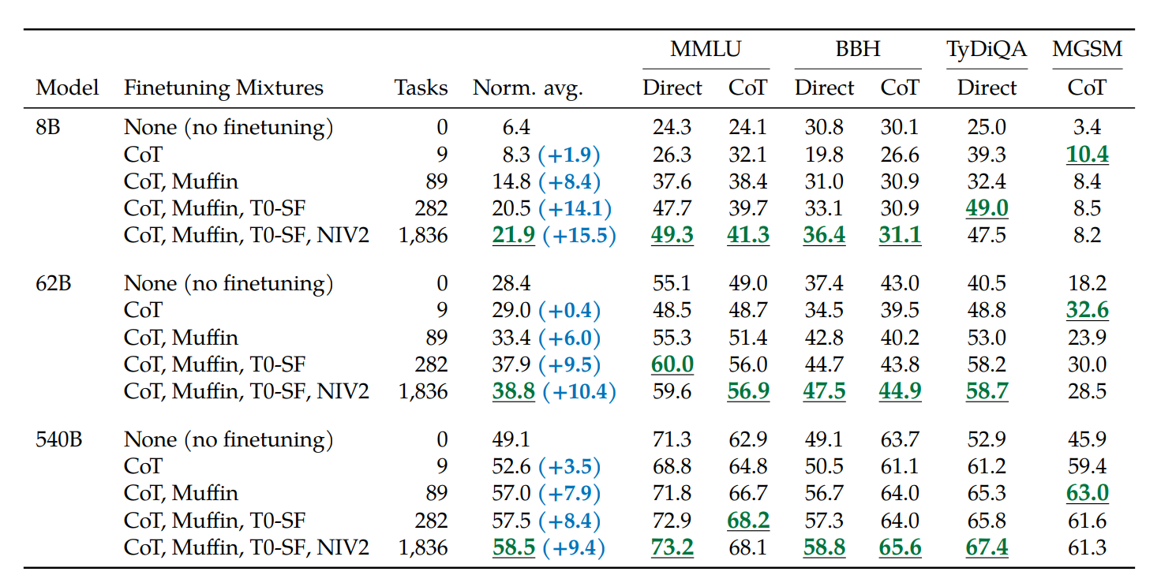
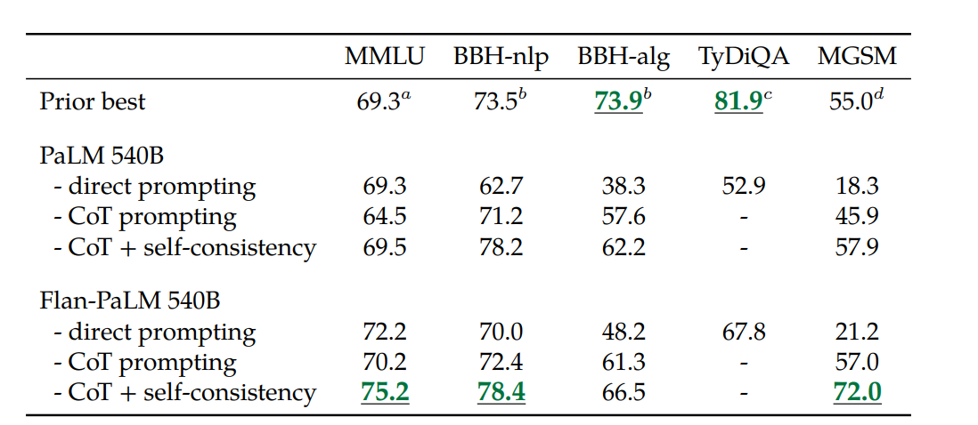
Instruction Finetuning Evaluation
→ Scaling up # of tasks, model sizes
→ Adding CoT tasks

Slide 37
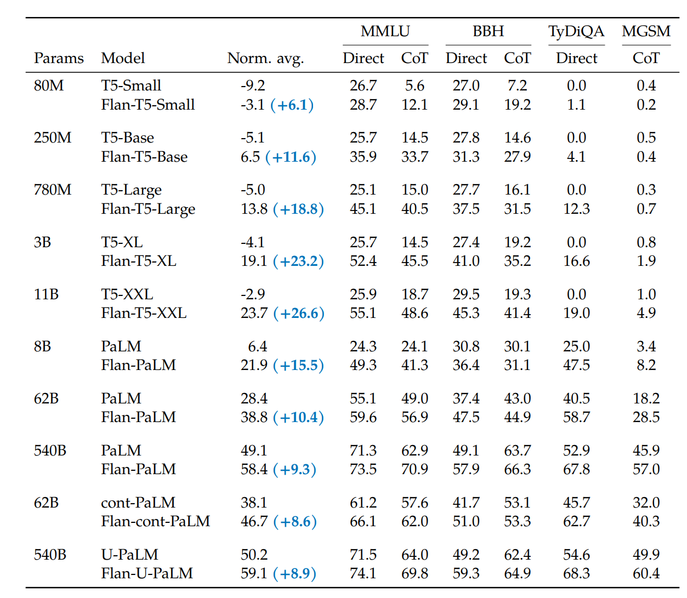
Instruction Finetuning Evaluation
Normalized average:
Random model의 accuracy를 0%로 하여
accuracy를 정규화한 값

